Slide 1
Class 11
BUS 696
Prof. Jonathan Hersh

Slide 2
BUS 696: Class 11 Announcements
Final Projects
Nov 14th summary stats due
Must summarize training data -> having performed feature transformation and cleaning
Next Class
“appetizers” at Provisions

Slide 3
BUS 696: Class 11 Outline
HBR AI Articles
Merging Datasets
Cleaning Factor Levels
Sentiment Data
Unsupervised Learning
K-means Clustering
Hierarchical Clustering
Principal Component Analysis

Slide 4
Merging Datasets – Primary Keys
Artist Table
Album Table
Table Key
Table Key
Album Name | Album ID | Artist ID
Thank Me Later | 1 | 2
Take Care | 2 | 2
Nothing Was The Same | 3 | 2
Views | 4 | 2
Scorpion | 5 | 2
Strangeways Here We Come | 6 | 3
Artist | Artist ID
Justin Bieber | 1
Drake | 2
The Smiths | 3
Real world datasets are stored in separate tables to save storage space
The unique (row) identifier for every observation in a table is called the primary key (or primary keys)

Slide 5
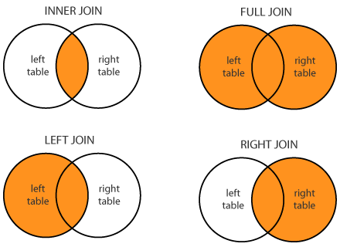
Merge Datasets – Types of Joins

Slide 6
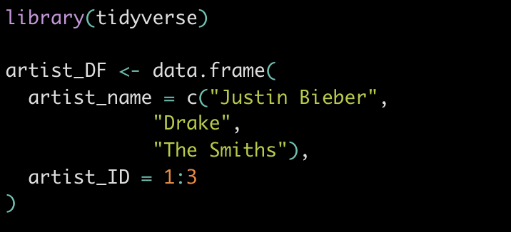
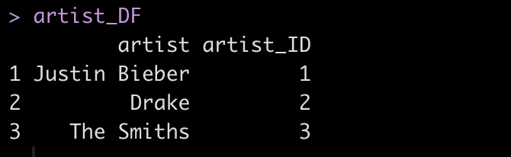
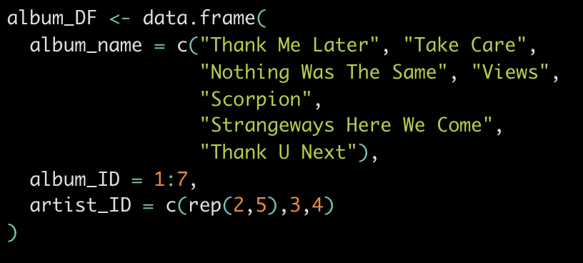
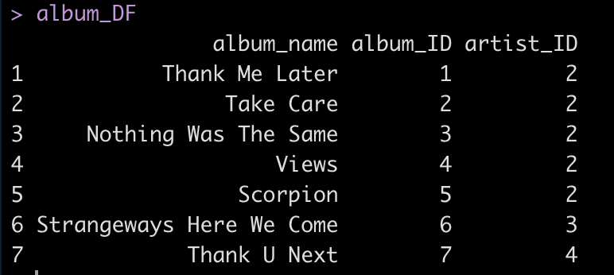
Let’s get some dummy data for merging

Slide 7
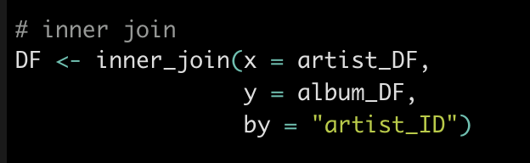
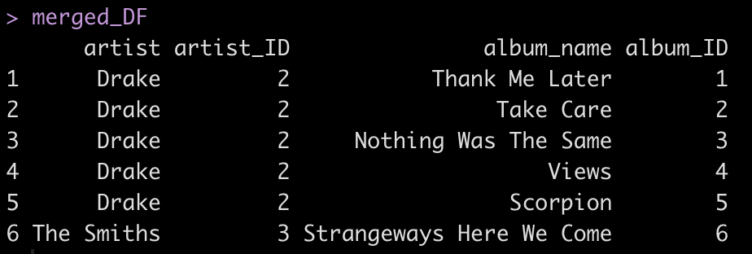
Inner Join: Returns All Albums That Match on Artist ID

Slide 8
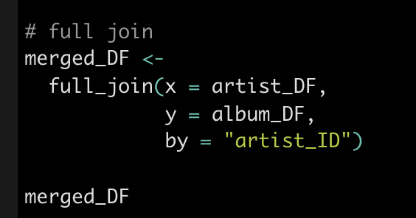
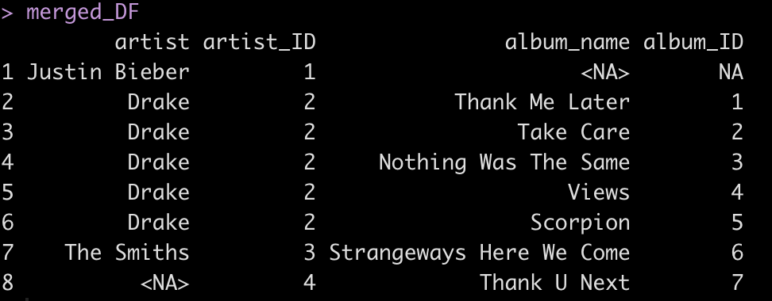
Full Join: Returns All Albums and All Artists, Regardless of Match
“NA”s introduced because information unknown across tables

Slide 9
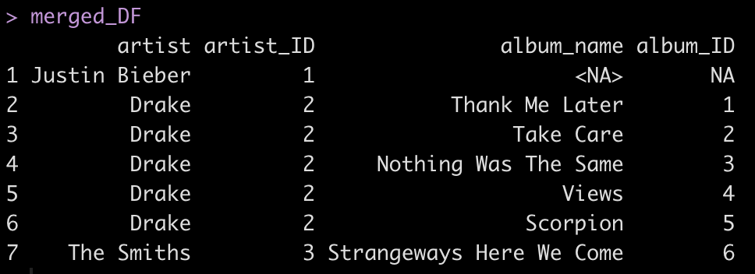
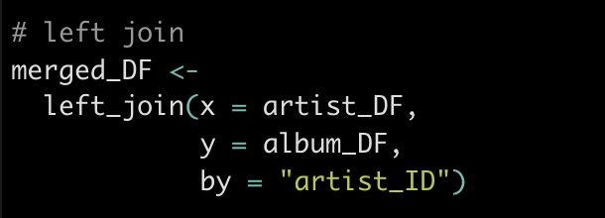
Left Join: Returns All Artists, and Matching Album ID Information
“NA”s for Justin’s album because no information in album table on his masterpieces

Slide 10
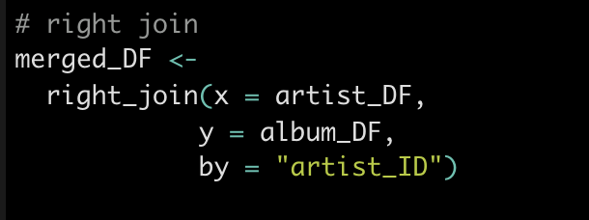
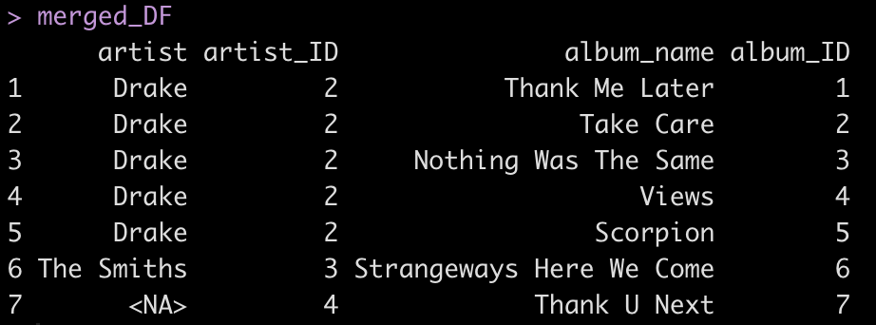
Right Join: Returns All Albums and Matching Artist Information
“NA”s for albums that don’t have an artist match

Slide 11
BUS 696: Class 10 Outline
HBR AI Articles
Merging Datasets
Cleaning Factor Levels
Sentiment Data
Unsupervised Learning
K-means Clustering
Hierarchical Clustering
Principal Component Analysis

Slide 12
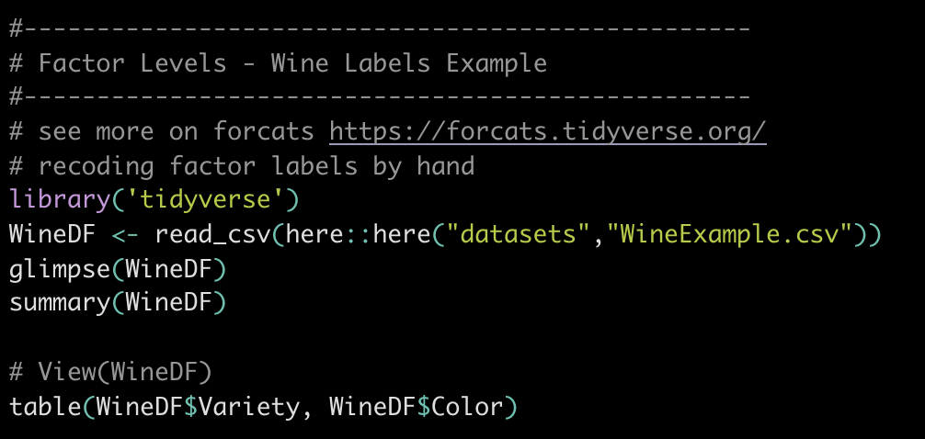
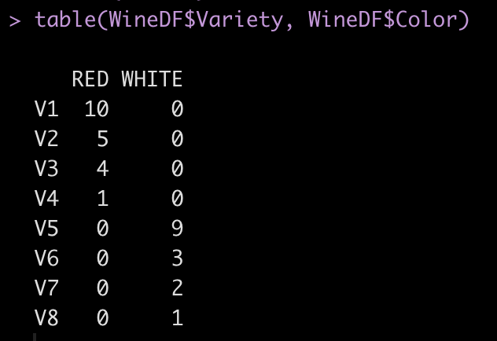
Wine Labels Example

Slide 13
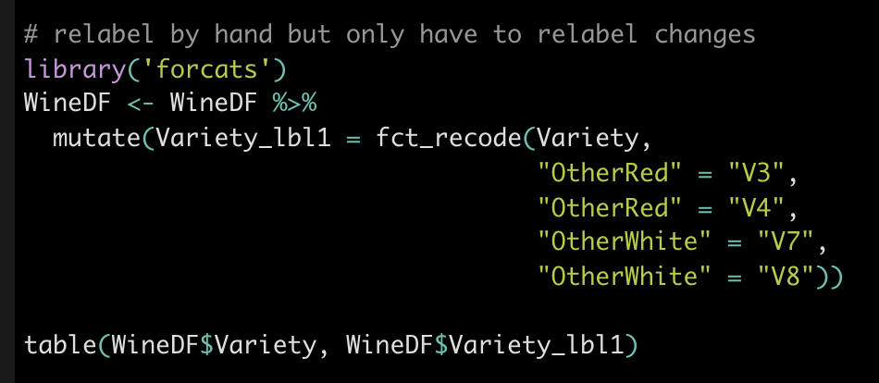
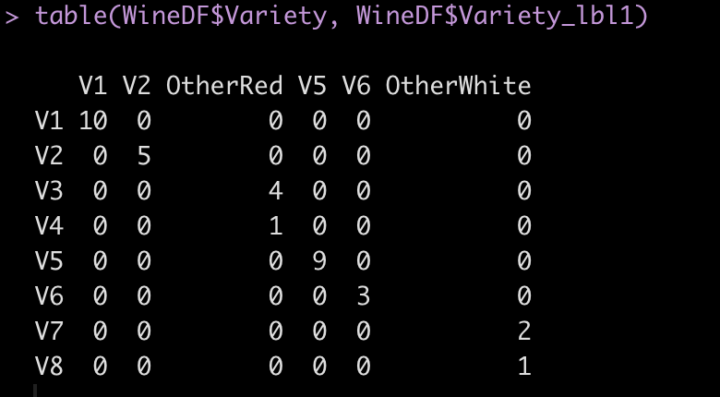
Relabeling Factor Levels Manually Using fct_recode()

Slide 14
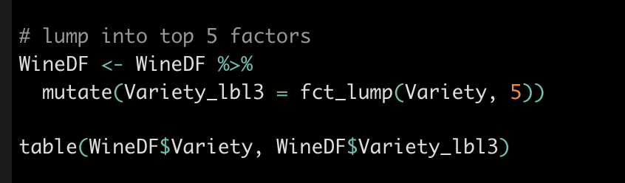
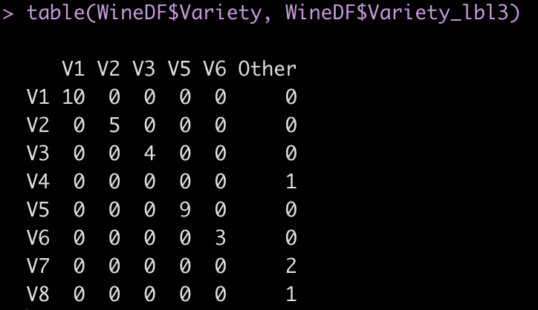
“Lumping” Factors Into Most Common and Creating an “Other” Category for the Rest

Slide 15
BUS 696: Class 10 Outline
HBR AI Articles
Merging Datasets
Cleaning Factor Levels
Sentiment Data
Unsupervised Learning
K-means Clustering
Hierarchical Clustering
Principal Component Analysis

Slide 16
Word Sentiments
Existing Libraries have mapped each word to a given “sentiment”
Sentiment is the average feeling invoked by a word

Slide 17
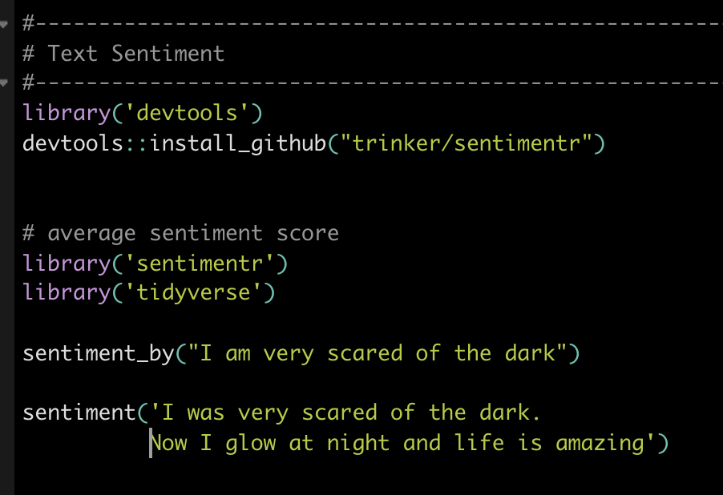
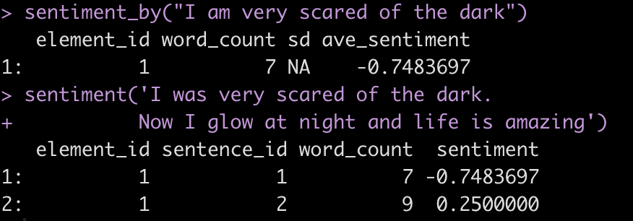
Extracting Sentiments from Words Using ‘Sentimentr’
Sentence 1 has negative sentiment
Sentence 2 has positive sentiment

Slide 18
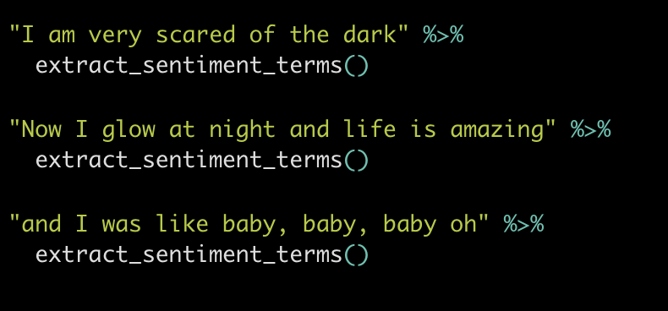
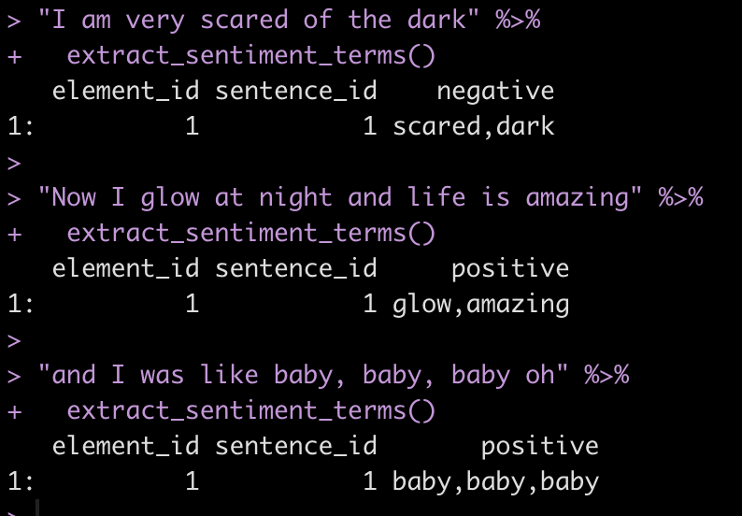
Which Words Affect Sentiment?

Slide 19
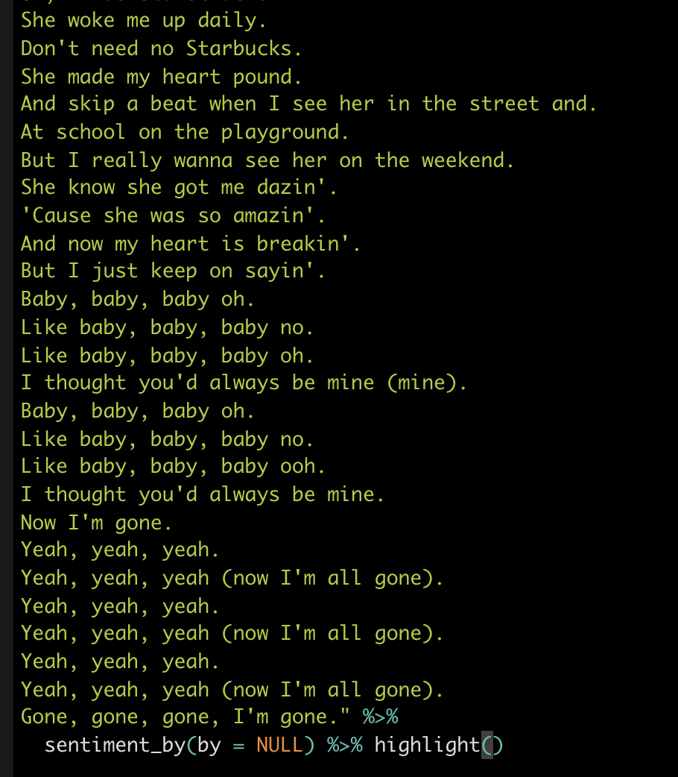
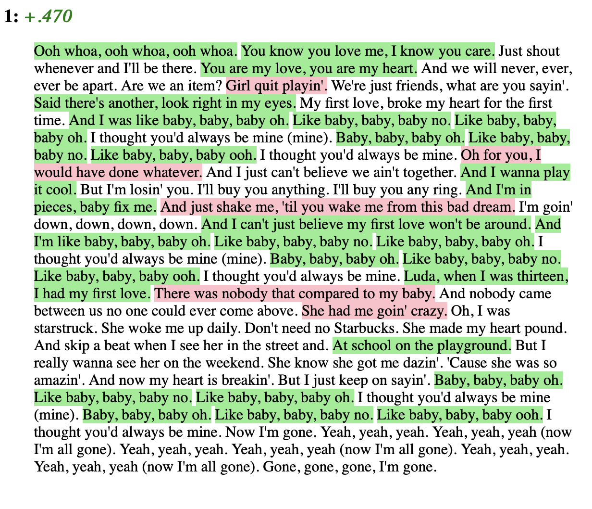
Visualizing Sentiment Scores: Red Negative Sentiment Green Positive

Slide 20
BUS 696: Class 10 Outline
HBR AI Articles
Merging Datasets
Cleaning Factor Levels
Sentiment Data
Unsupervised Learning
K-means Clustering
Hierarchical Clustering
Principal Component Analysis

Slide 21
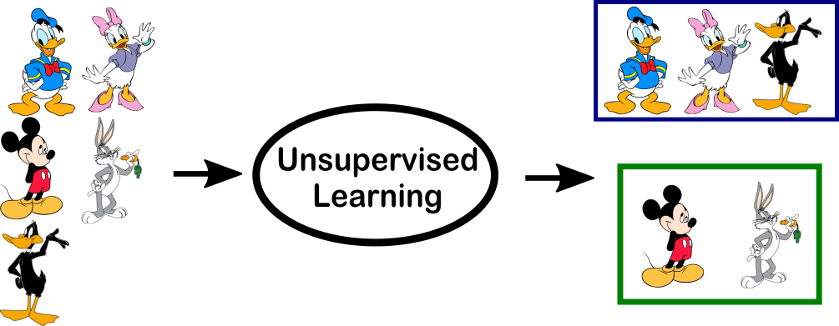
What is unsupervised learning?
All of the machine learning we’ve encountered so far has been supervised learning such as regression
This last lecture will describe unsupervised learning
In unsupervised learning, we observe $x_{1}, x_{2}, x_{p}$, features but we don’t observe any $Ys$

Slide 22

Goals of unsupervised learning
Since we don’t observe $Y′s$, we can’t predict anything
The goal is more subtle here: can we discover interesting patterns in the data? Can we discover useful subgroups?
We’ll discuss two methods
clustering: a broad class of methods for discovering unknown subgroups
principal component analysis: a tool used for data visualization and dimension reduction

Slide 23
Challenge of unsupervised learning
Because we have no “truth”, the end result is more subjective
Some examples of unsupervised learning
subgroup of breast cancer patients that by gene expression are drug resistant
groups of shoppers characterized by browsing and purchase histories
movies grouped by ratings assigned by movie viewers

Slide 24
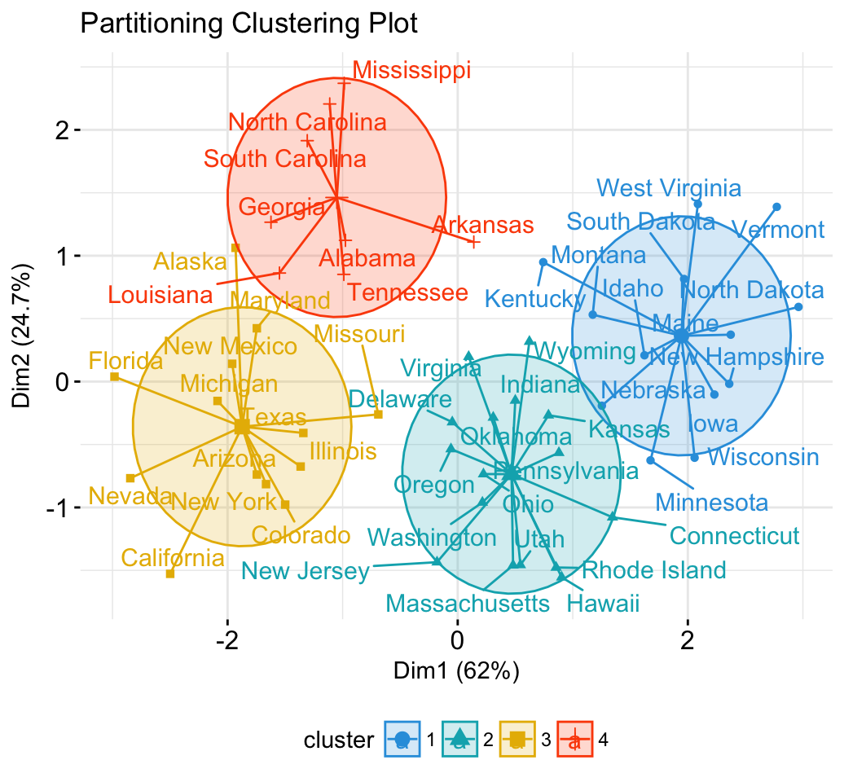
K-means clustering as a “game”
Tell the computer how many groups ($k$) you think the data should be split into
The computer splits the objects into $k$ groups such that the groups are most similar

Slide 25
K-means clustering algorithm
Decide how many clusters we want. Call this K
Randomly assign a number, 1, . . . ,K, to each of the observations. (Initial cluster assignment)
Iterate until clusters stop changing:
Expectation-step: For each of the K clusters, compute the cluster centroid (center point, i.e. means for the k-th cluster)
Maximization-step: Assign each observation to the cluster whose centroid is closest (in Euclidean distance)

Slide 26
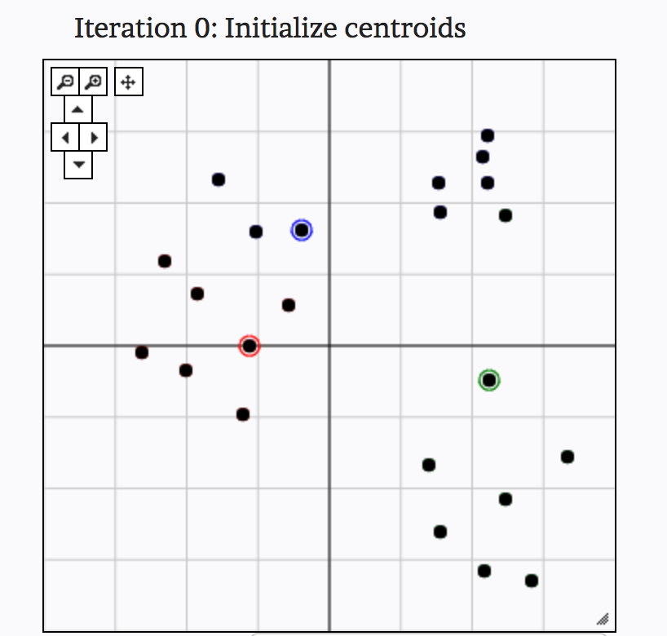
K-means clustering in action
From: http://util.io/k-means

Slide 27
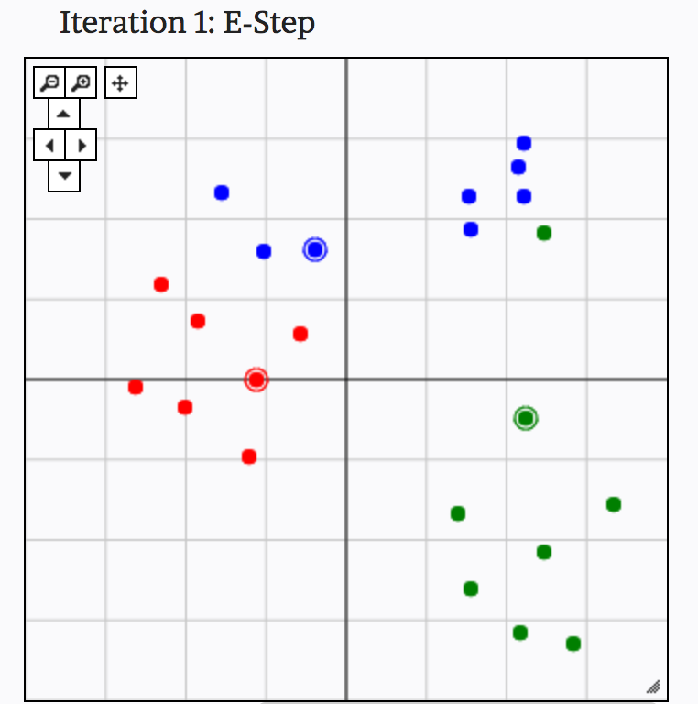
K-means clustering in action
From: http://util.io/k-means

Slide 28
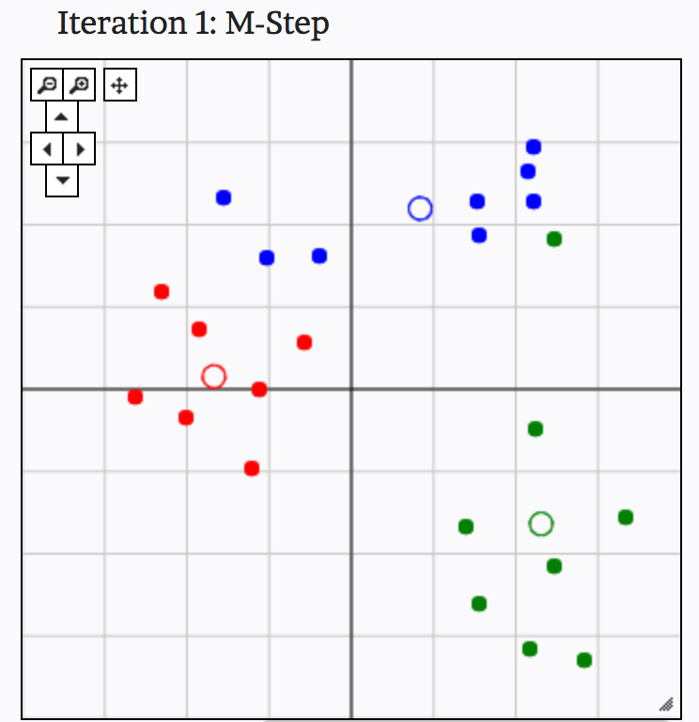
K-means clustering in action
From: http://util.io/k-means

Slide 29
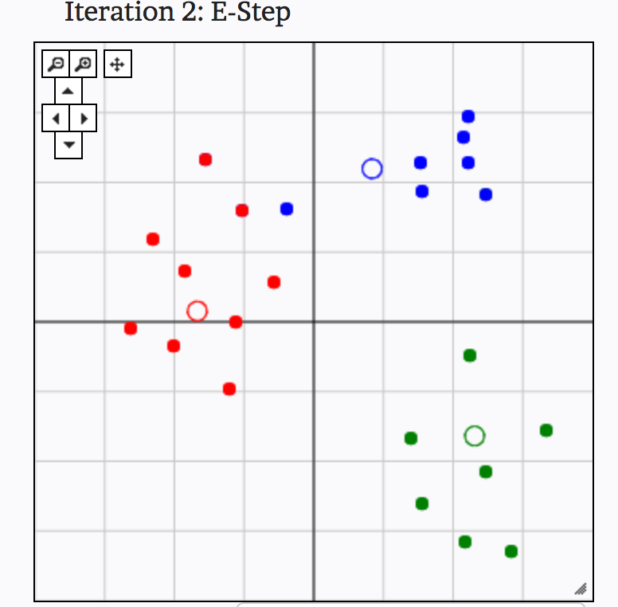
K-means clustering in action
From: http://util.io/k-means

Slide 30
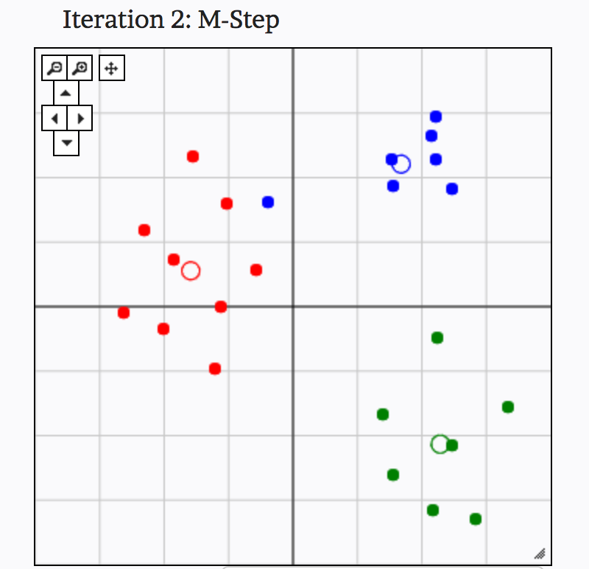
K-means clustering in action
From: http://util.io/k-means

Slide 31
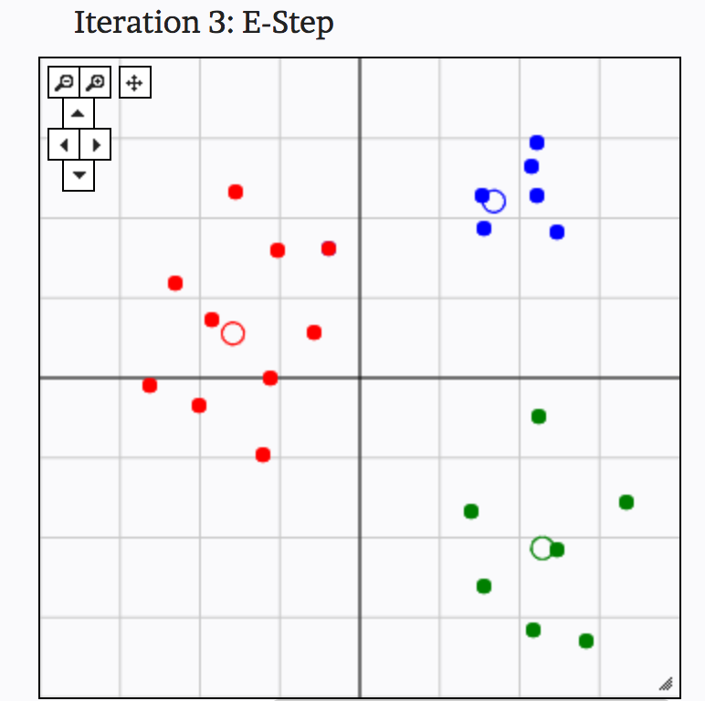
K-means clustering in action
From: http://util.io/k-means

Slide 32
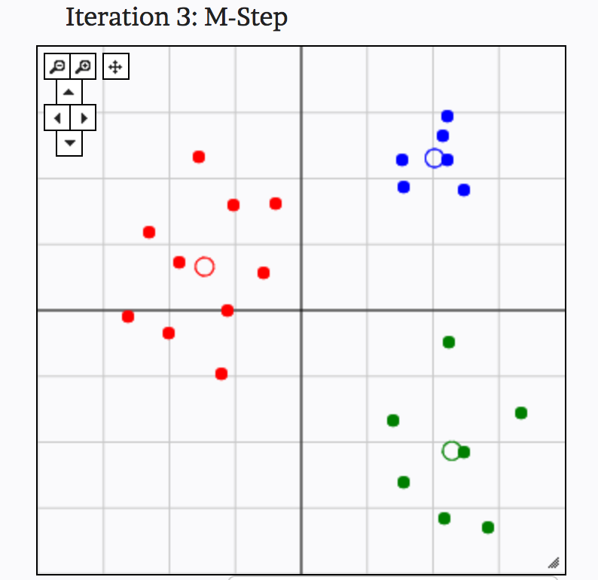
K-means clustering in action
From: http://util.io/k-means

Slide 33
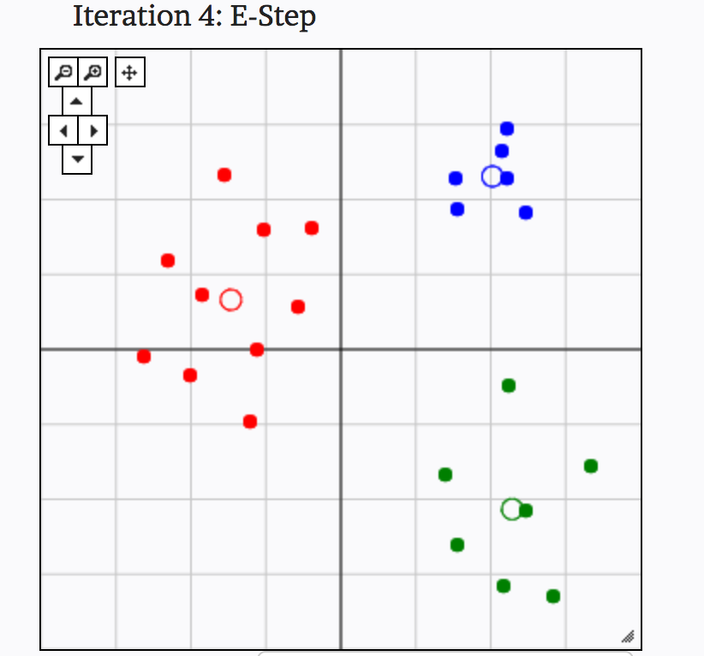
K-means clustering in action
From: http://util.io/k-means

Slide 34
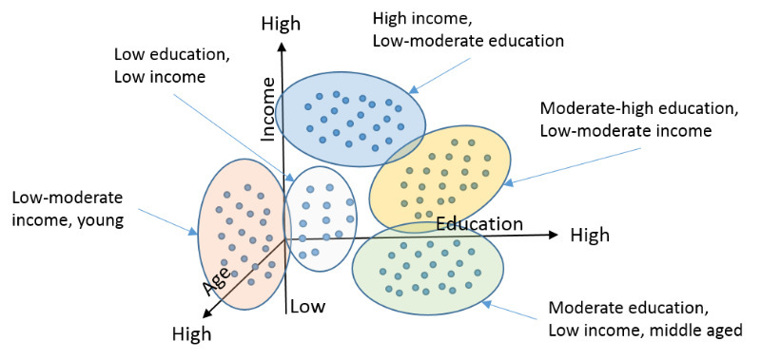
Examples of clustering: Customer Segmentation

Slide 35
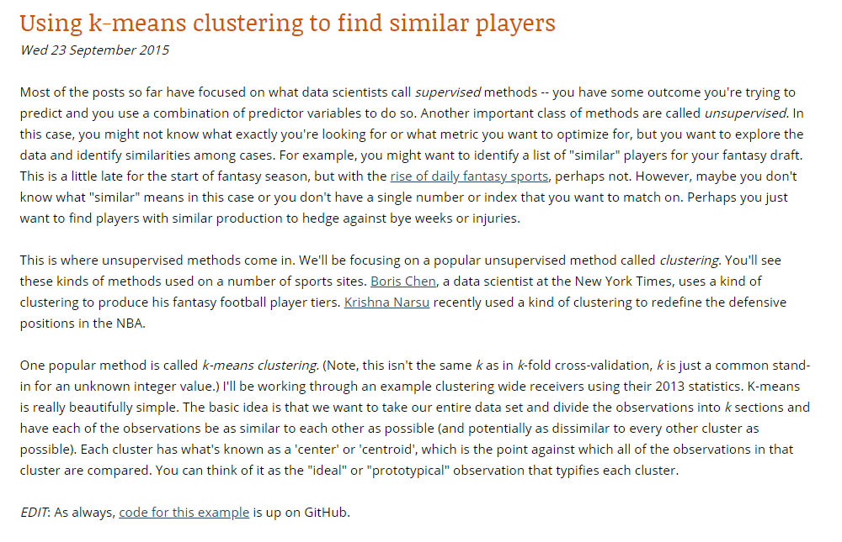
Examples of clustering: Clustering Wide Receivers
From: http://thespread.us/clustering.html

Slide 36
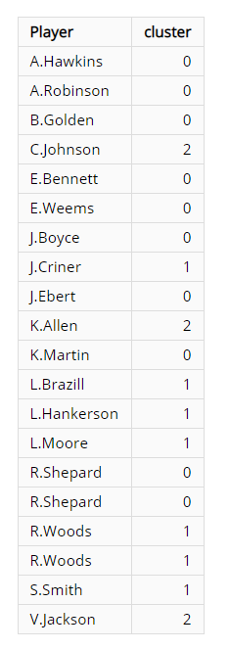
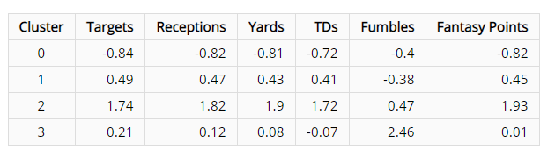
Examples of clustering: Clustering Wide Receivers
From: http://thespread.us/clustering.html

Slide 37
Plan for Today
What topics to cover for Data Management?
Merging data
Dplyr basics
What else?
No problem set 11 (is that okay?)
Signup for presentations
Monday, Dec 3rd
Wednesday, Dec 5th
Hierarchical clustering
K-means code
PCA
PCA code

Slide 38
Hierarchical clustering algorithm
Begin with n observations and calculate all of the pairwise dissimilarities. Treat each observation as its own cluster
For i = n, n − 1, . . . , 2 :
Examine all pairwise inter-cluster dissimilarities among the i clusters and identify the clusters that are most similar. Fuse these two clusters.
Compute the new pairwise inter-cluster dissimilarities among the i − 1 remaining clusters

Slide 39
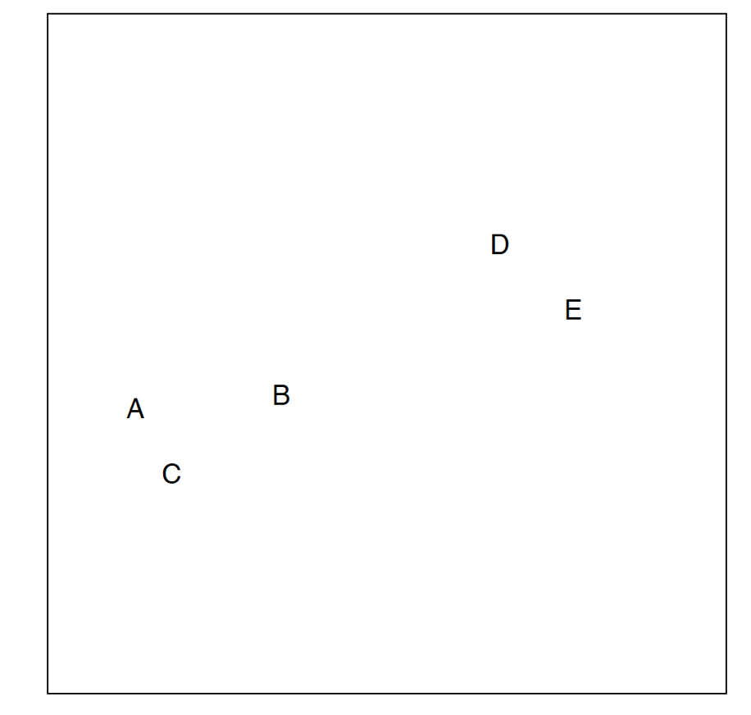
Hierarchical clustering in action

Slide 40
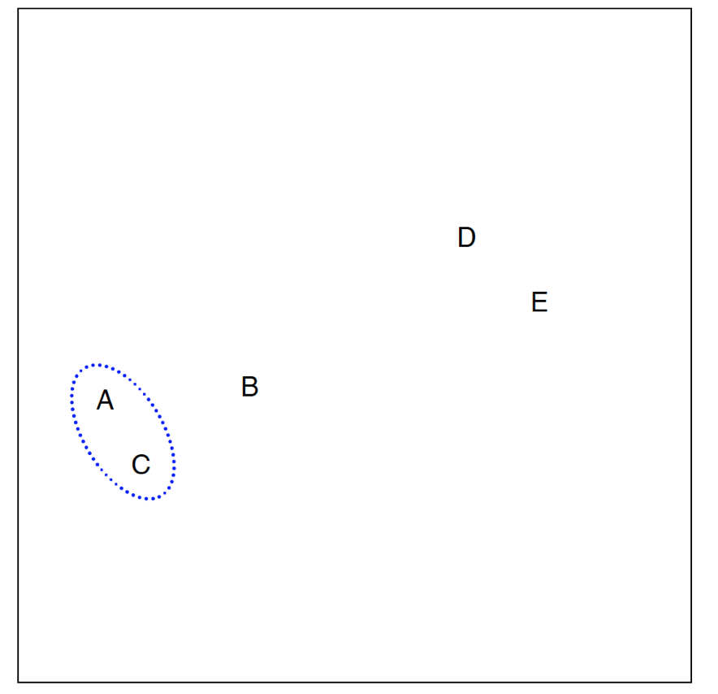
Hierarchical clustering in action

Slide 41
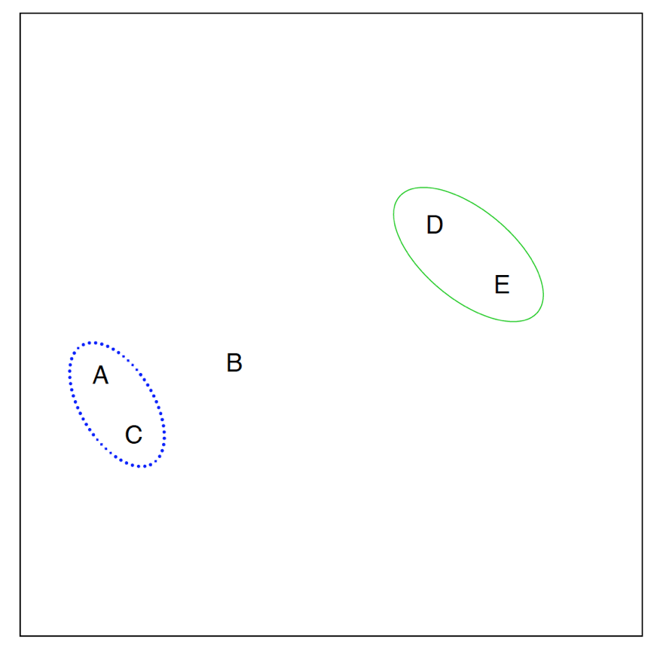
Hierarchical clustering in action

Slide 42
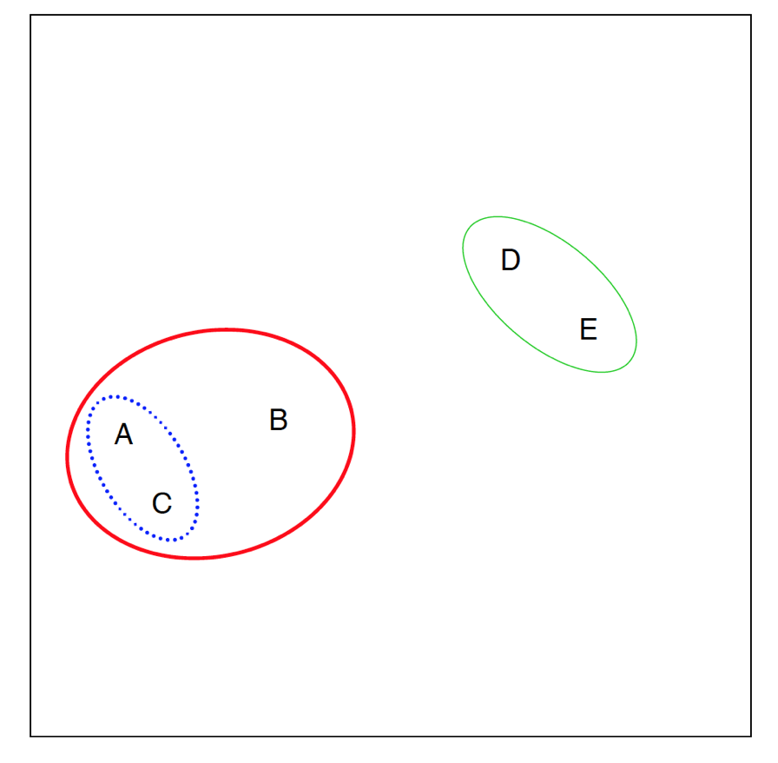
Hierarchical clustering in action

Slide 43
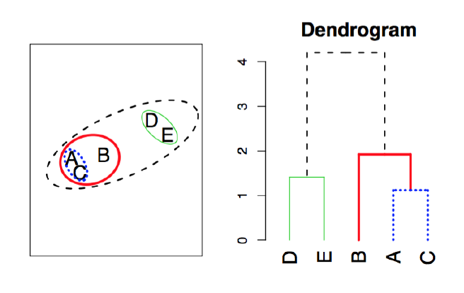
Connection to “dendrograms”

Slide 44
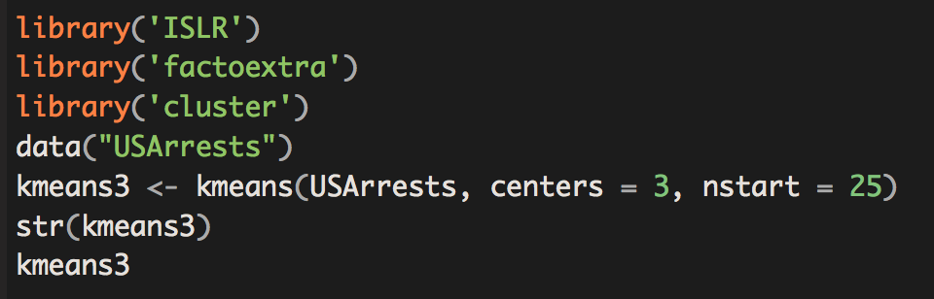
K-means in R

Slide 45
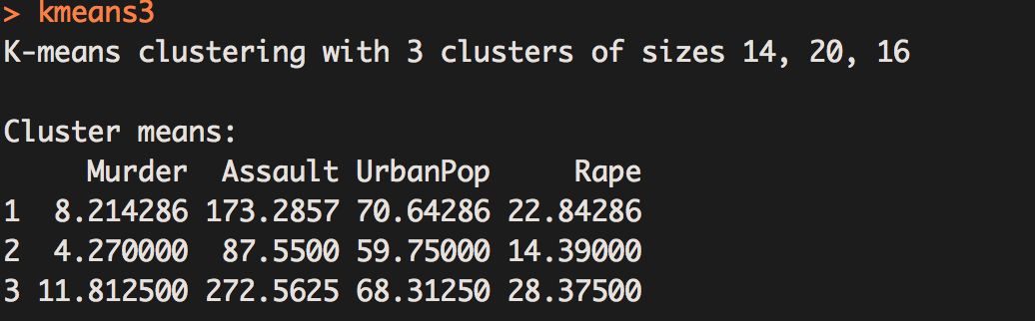
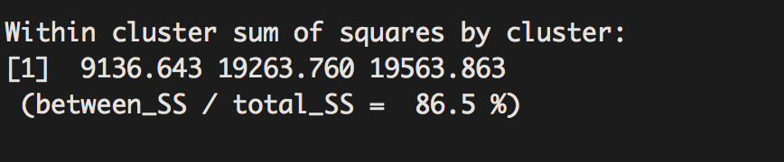
K-means in R

Slide 46
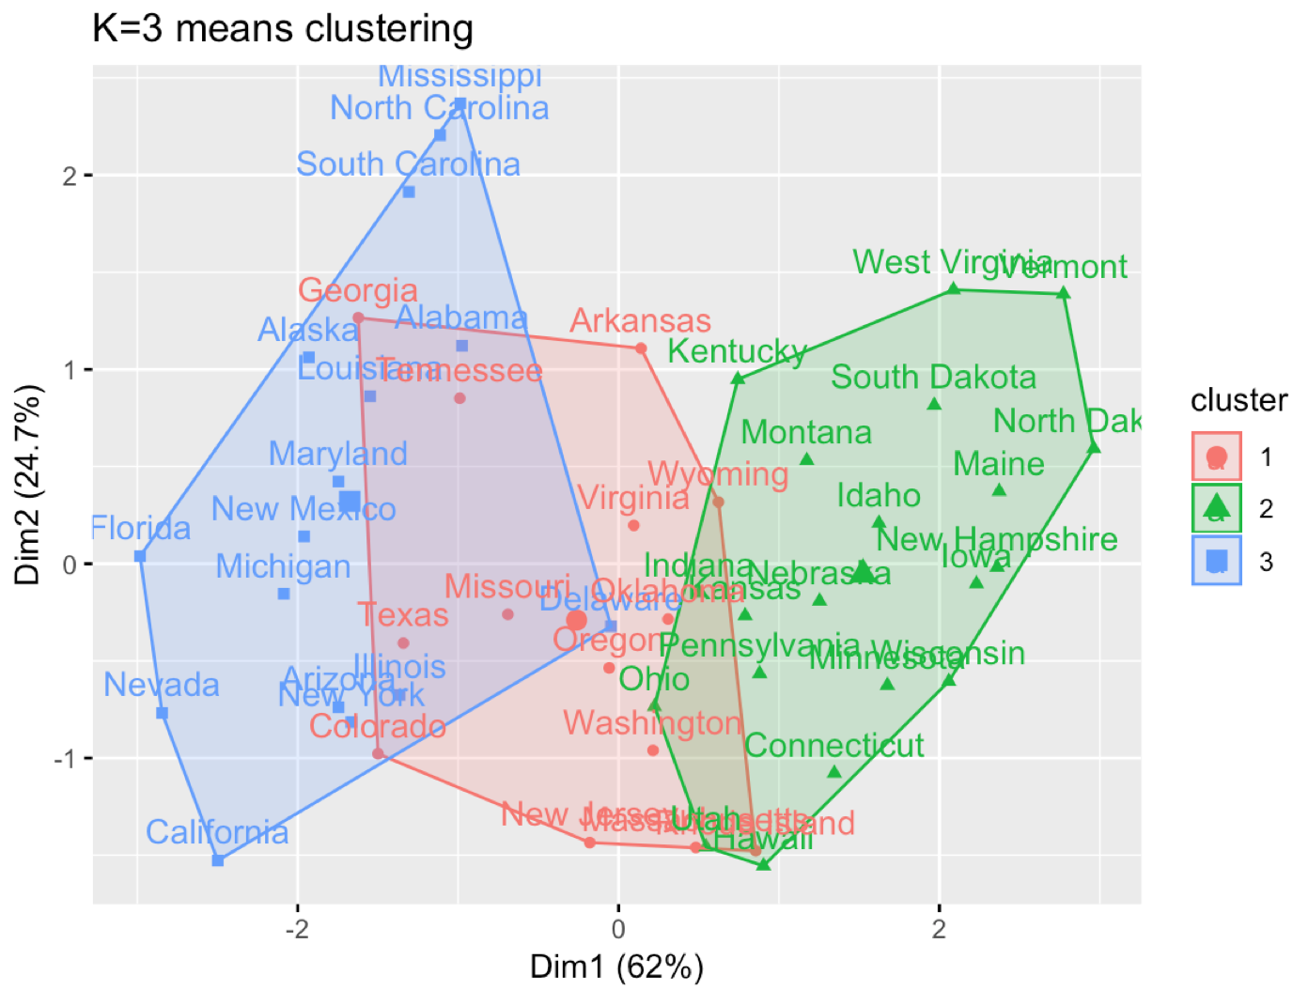

Slide 47
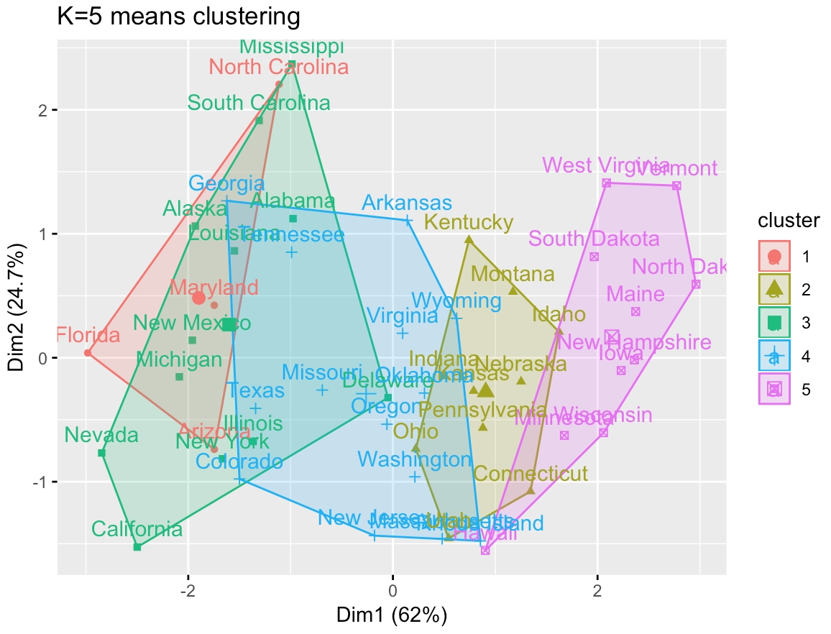

Slide 48
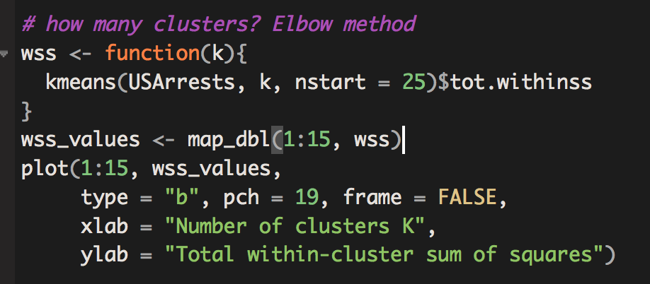
How to pick k? “Elbow Method”
Plot explained variance by # of clusters
Look for the “bend” in the plot

Slide 49

Within-cluster sum of squares by # of clusters

Slide 50
How to pick k?
Silhouette score:
$a_{i}=$ measure of dissimilarity between point i and other observations in its cluster.
1 = good match with cluster
-1 = really bad match
$b_{i}=$ measure of dissimilarity between i and all other points in any cluster
$s_{i}=\frac{b_{i}−a_{i}}{\max\left\{a_{i}, b_{i}\right\}}$

Slide 51

Silhouette Score

Slide 52

Silhouette Score

Slide 53
Motivation for Dimension Reduction 1
Suppose we want to visualize $n$ observations that have $p$ variables, $X_{1},…,X_{n}$
We could examine every two-dimensional sub-plot
However, that would be $\left(how many\right)$ subplots?
$\left({p \atop 2}\right)=\frac{p(p−1)}{2}$
How do we visualize data to see how “far apart” certain observations are from one another?

Slide 54
Motivation for Dimension Reduction 2
Sometimes in a regression setting, we care about controlling for many characteristics, but don’t care about interpreting those characteristics.
We can take those control variables, project them down into a lower dimensional subspace, then control for only those lower dimensional variables
E.g. take 100 controls variables, project down to 2 dimensions, and only control for those 2 variables

Slide 55
Enter Principal Component Analysis
PCA produces a low-dimensional representation of a dataset.
It does so by finding directions of maximal variance that are mutually orthogonal
In other words it asks the question
If I had to pick a set of direction such that if I projected the data onto those directions, and then computed the variance of the points, which directions would maximize explained variance?

Slide 56
First Principal Component
PCA finds sequence of linear combinations of the variables that maximize variance and are mutually uncorrelated
The first principal component of a set of features $X_{1},X_{2},…,X_{p}$ is the normalized linear combination of the features
$$Z_{1}=φ_{11}X_{1}+φ_{21}X_{2}+…+φ_{p1}X_{p}$$
That have the largest variance
Normalized here means $\sum_{j=1}^{p}{φ_{j1}^{2}}=1$
$φ_{1}={\left(φ_{11}φ_{21}…φ_{p1}\right)}^{T}$ is the vector of factor loadings of the first principal component

Slide 57

First Principal Component

Slide 58
Second Principal Component
After we have calculated the first principal component,$Z_{1}$, the second principle component is the linear combination of $X_{1},⋯,X_{p}$ that has maximal variance out of all linear combinations that are uncorrelated with $Z_{1}$
The second principal component takes the form
$Z_{2}=φ_{12}X_{1}+φ_{22}X_{2}+…+φ_{p2}X_{p}$
$φ_{2}={\left(φ_{12}φ_{22}…φ_{p2}\right)}^{T}$ is the vector of factor loadings of the second principal component
Constraining $Z_{2}$ to be uncorrelated with $Z_{1}$ is equivalent to constraining $X_{1}$ to be orthogonal (perpendicular) to $X_{2}$

Slide 59

Second Principal Component

Slide 60

Second Principal Component

Slide 61
PCA Illustration
USAarrests data: For each 50 state in the US, number of arrests per 100,000 residents for each of the three crimes: assault, murder, and rape. Also record UrbanPop.
Principal component score vectors have a length of n = 50, and loading vectors have length p = 4
PCA was performed after standardizing variables to have a mean of 0 and standard deviation of 1.

Slide 62

PCA Illustration

Slide 63

PCA Illustration
Factor
loadings

Slide 64

How many PCAs to use? “Elbow Method” from “Skree” plot

Slide 65

Plotting PC1 and PC2
As promised, we can now use the 1st and 2nd principal component to visualize the P-dimensional data on a 2-dimensional plot
This is called “projecting” our data in 2 dimensions

Slide 66

PCA “Biplot”

